Slide 1
Process scheduling algorithms

Slide 2
Scheduling Policies (cont'd.)
Types of scheduling policies
Preemptive
Used in time-sharing environments
Interrupts job processing after a specific amount of time if there has been no other interrupts
Transfers CPU to another job
Non-preemptive
Functions without external interrupts
a job or process remains in a running state until interrupted by internal interrupts e.g. I/O request: used in batch systems

Slide 3
Non pre-emptive algorithms
First-come, first-served (FCFS).
Uses the arrival time of the job/process to pick a process to run on the CPU.
Shortest job next (SJN).
Uses the CPU cycle time.
Priority scheduling
Uses a priority system with highest priority jobs scheduled first.

Slide 4
1 First-Come, First-Served
Nonpreemptive
Job handled based on arrival time
Earlier job arrives, earlier served
Simple algorithm implementation
Uses first-in, first-out (FIFO) queue
Good for batch systems
Unacceptable in interactive systems
Unpredictable turnaround time
Disadvantages
Average turnaround time varies; seldom minimized

Slide 5


(figure 4.6)
Timeline for job sequence A, B, C using the (first come first serve) FCFS algorithm. Note: Average turnaround time: (15 +17 + 18)/3 = 16.67
(figure 4.7)
Timeline for job sequence C, B, A using the FCFS algorithm. © Cengage Learning 2014 Note: Average turnaround time: 7.3

Slide 6
2 Shortest Job Next (SJN)
Nonpreemptive
Also known as shortest job first (SJF)
Job handled based on length of CPU cycle time
Easy implementation in batch environment
CPU time requirement known in advance
Does not work well in interactive systems
Optimal algorithm
All jobs are available at same time
CPU estimates available and accurate

Slide 7

Shortest Job Next (cont'd.)
A:5, B:2, C:6:, D:4 (arrive at the same time)
(figure 4.8)
Timeline for job sequence B, D, A, C using the SJN algorithm.
What is the average turnaround time ?

Slide 8
Pre-emptive algorithms
Shortest remaining time (SRT)
Round robin:

Slide 9
4 Shortest Remaining Time
Preemptive version of SJN
Processor allocated to job closest to completion
Preemptive if newer job has shorter completion time
Used in batch environments cannot be used in interactive systems
Short jobs given priority
Cannot implement in interactive system
Requires advance CPU time knowledge
Involves more overhead than SJN
System monitors CPU time for READY queue jobs
Performs context switching

Slide 10
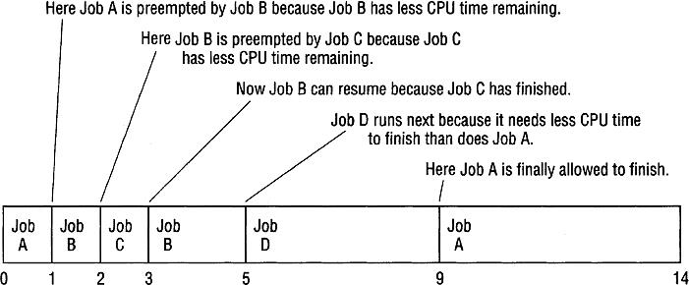
SRT Example
Arrival Time | 0 | 1 | 2 | 3
Job | A | B | C | D
CPU cycle | 6 | 3 | 1 | 4

Slide 11
Average time to complete a job
Job | A | B | C | D
Completion time minus arrival time | 14- 0 | 5-1 | 3-2 | 9-3
Turnaround | 14 | 4 | 1 | 6
Average turn around time is ?
Home Work:
Using the schedule as above what is the turn around time for a system using the SRT algorithm?

Slide 12
5 Round Robin
Preemptive
Used extensively in interactive systems
Based on predetermined time slice (time quantum)
Each job assigned time quantum
Time quantum size
Crucial to system performance
Varies from 100 ms to 1-2 seconds
CPU equally shared among all active processes
Not monopolized by one job

Slide 13
Round Robin (cont'd.)
Job placed on READY queue (FCFS scheme)
Process Scheduler selects first job
Sets timer to time quantum
Allocates CPU
Timer expires
If job CPU cycle > time quantum
Job preempted and placed at end of READY queue
Information saved in PCB

Slide 14
Round Robin (cont'd.)
If job CPU cycle < time quantum
Job finished: allocated resources released and job returned to user
Interrupted by I/O request: information saved in PCB and linked to I/O queue
Once I/O request satisfied
Job returns to end of READY queue and awaits CPU

Slide 15
Round Robin (cont'd.)
Arrival Time | 0 | 1 | 2 | 3
Job | A | B | C | D
CUP cycle time | 8 | 4 | 9 | 5
Timeline for job sequence A, B, C, D using the preemptive round robin algorithm with time slices of 4 ms.
Jobs A = (0, 8 ms), B (1, 4 ms), C (2, 9 ms) D (3, 5ms) (in this example assuming no I/O requests). It also use a FIFO queue
What is the average turnaround time?
(20 + 7 +24 + 22)/4 = 18.25 (to calculate time finishing time – arrival time)

Slide 16
Round Robin (cont'd.)
Efficiency
Depends on time quantum size
In relation to average CPU cycle
Quantum too large (larger than most CPU cycles)
Algorithm reduces to FCFS scheme
Quantum too small
Context switching occurs (a job is pre-empted )
Job execution slows down
Overhead dramatically increased

Slide 17
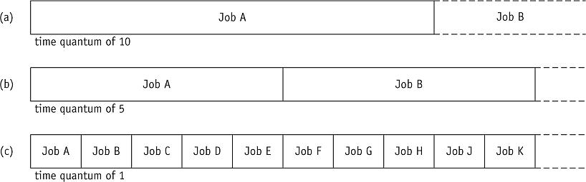
Round Robin (cont'd.)
(figure 4.12)
Context switches for three different time quantums. In (a), Job A (which requires only 8 cycles to run to completion) finishes before the time quantum of 10 expires.
In (b) and (c), the time quantum expires first, interrupting the jobs. © Cengage Learning 2014

Slide 18
Round Robin (cont'd.)
Best quantum time size
Depends on system
Interactive: response time key factor
Archival system: turnaround time key factor
General rules of thumb
Long enough for 80% of CPU cycles to complete
At least 100 times longer than context switch time requirement

Slide 19
Conclusion
Processor Manager allocates CPU among all users
Job scheduling
Based on characteristics
Process and thread scheduling
Instant-by-instant allocation of CPU
Interrupt handler: generates and resolves interrupts
Each scheduling algorithm is unique
Characteristics, objectives, and applications
System designer selects best policy and algorithm
After careful strengths and weaknesses evaluation

Slide 20
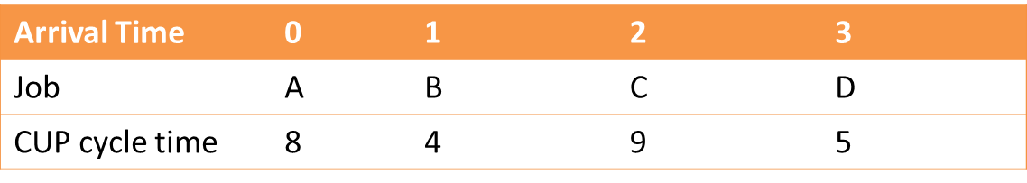
Sample question
Describe, using a suitable example one type of non-premptive scheduling algorithm (10 marks)
Given the following process and their arrival times determine the completion time for the round robin algorithm with a time slice of 3 and the shortest time first algorithm.

